Slide 1
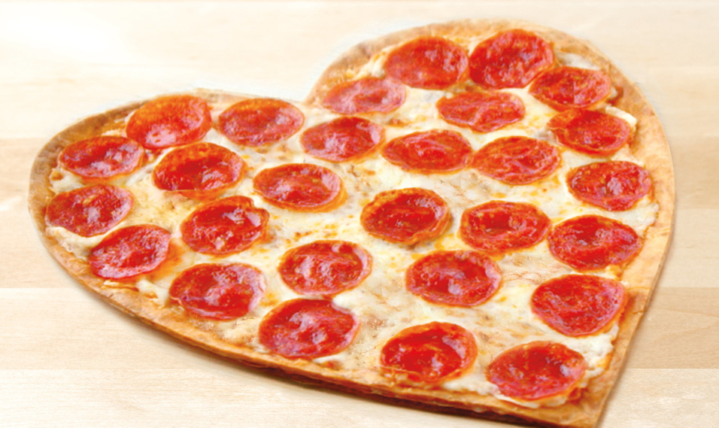
W207 Final
Random Acts of Pizza
Nichole Haas
Jayashree Raman
David Skarbrevik
Notes:
David

Slide 2

Background and Project Description
Project: Random Acts of Pizza (a subreddit)
Data Profile:
4040 observations X 32 features
Text and numeric data types
Eg. sentences, vote counts, dates
Goal:
Predict whether a specific post in this subreddit will be rewarded with pizza.
Notes:
David
We selected the random acts of pizza competition because it sounded like fun at the time. For those that do not know, RAOP is a reddit community where users can gift pizza to each other. The Kaggle competition is a machine learning contest designed to predict which pizza requests would be granted. We didn’t realize it at the time nearly 5 weeks ago that we’d end up with the urge to order many pizzas and net 2 inches on our waistlines before the project was over.
The competition hosts provided a training set of 4,040 observations with 32 features. The testing set sadly only had 17 features, so about half the features could not be used. The feature space included text data, like the request text and title; numeric data, like the age of the redditor’s account; categorical data, like subreddit membership, time data, like the unix timestamp at request; and boolean data, like if the requester used flair.

Slide 3
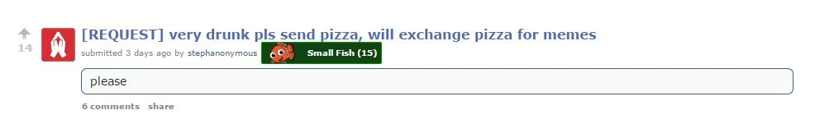
Example Data and Problem Description
number_of_upvotes_of_request_at_retrieval
request_title
request_number_of_comments_at_retrieval
flair
request_text
Notes:
David
Here’s the anatomy of a RAOP request.
The flair is the cute little nemo guy, and signifies a RAOP redditors status of giving and receiving. Recipient, Trader, Giver and Pizza Tycoon are types of flair indicating if a user have given, received, or given and received pizza. The request title was provided to us, along with the text. We get total upvotes along with upvotes plus downvotes and upvotes minus downvotes. We also get some summary stats on the user, like how old their account is, which is not apparent from this view, but can be found out with some digging. We used these features and some engineered features to build our model.

Slide 4
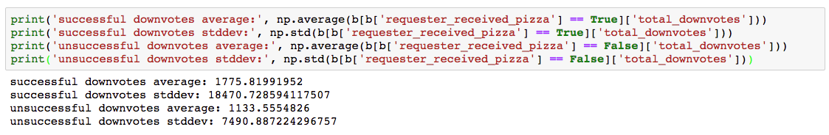
Feature Engineering and EDA
Function human_time() that pulls features for day of the week, month of year, and time of day
Hypothesis: month of year and day of week will matter
Findings: Wednesday Evenings is the most promising time to request pizza
Feature total_downvotes
Included with test data, but not train data
Can be synthesized from data in training set
b['total_downvotes'] = (b['requester_upvotes_plus_downvotes_at_request'] - b['requester_upvotes_minus_downvotes_at_request'])/2
Normalizing Numeric data
MaxAbsScaler()
Notes:
David
Our first feature engineering extracted features from the timestamp. We created a function called human_time that took the unix timestamps for UTC and Local, gave back the proper timestamp, the day of the week, time of day, and month in which the request was made. We hypothesized that the months of November and December would net more successful pizza requests, because redditors would be feeling more generous in the Christmas season. We also figured that requests made at the end of the week would be most promising, as paycheck tend to be issued on Thursdays and Fridays from most employers. Finally, we assumed that extremely early and extremely late requests would not net pizza, as pizza delivery doesn’t really happen in the morning, and not many people are awake extremely late at night. The PCA analysis Nikki will talk about in a minute confirmed a few of these hypotheses but rejected a few others. It appears that Wednesday evenings boost your chances of free pizza.
Total downvotes seemed like a really handy metric, but it was not included in the test data. The test data did have total up plus down and total up minus down votes, so through the amazing powers of algebra, we were able to synthesize the total downvotes for both the training and testing set. We hypothesized that the greater number of total downvotes, the less likely a requests would be granted. Now, that wasn’t necessarily effective. A successful request did have less downvotes, but the standard deviations for both sets was pretty big, so we knew the difference wouldn’t matter to the final model statistically.
Normalizing the numeric data was one of the most effective things we tried. To normalize numeric data, you subtract the mean and divide by the standard deviation. That sounded like a lot of work, so we used an SKLearn built in function called MaxAbsScalar() which effectively maps data of any range to (0,1). Normalizing the numeric data netted us a half a percent accuracy in the model, on average.

Slide 5
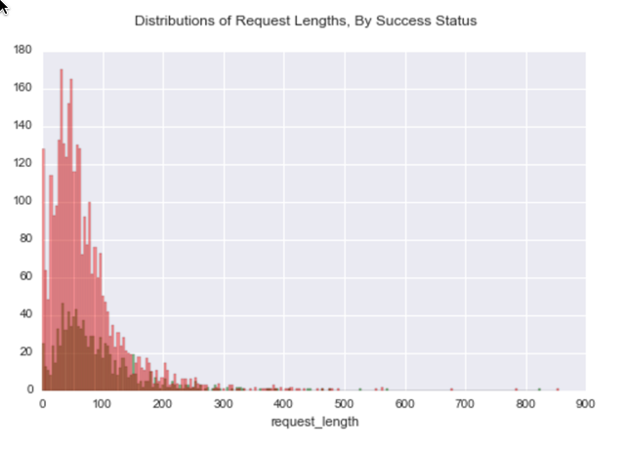
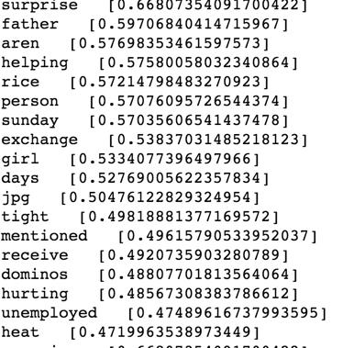
Feature Engineering and EDA
What are the most important words in the request documents? Using Tf-idf
Does the request length matter?
Notes:
Nikki
At first glance, the feature for request length seems promising. Obviously, if some drunk kids post the single word “please” as their request like David showed, this may not be as powerful as a few paragraphs explaining why the request was made. The average length of a granted request was about 18 words longer than requests that were denied. However, let’s unpack this a little more. We checked the standard deviation for both subgroups and found that the standard deviations were very spread out. Unfortunately, that meant the averages for both groups were within one standard deviation of each other. We didn’t even have to use inference to know this was not a spectacular difference. When we overlay plots of the distribution of the two sets (denied requests are red, granted requests are green), we can see they both follow poisson distributions and have wide spreads. When allowing for noisy bins like we did here, we can see that they peak at near the same place, given the spread. Even the logspace of these two distributions didn’t show much of a difference in peaks. So, the statistics did not support including the request lengths.
Next, we checked the tops words in the successful request documents to see what they were, and what we can learn from them. And the top words are very sweet. I’d like to think that many successful requests were for a nice surprise of pizza for someone’s unemployed father who really likes Dominos and has been living on rice. It’s not here, but trust me on this, one of the top words for unsuccessful requests was “Florida.” So, Florida doesn’t get much love anywhere, much less RAOP. We tried parsing down the vocabulary by using only the top words, however we had a better model when used the entire vocabulary.

Slide 6
Sensible Methods - Initial Model
sklearn.pipeline.Pipeline() on text data
sklearn.pipeline.FeatureUnion() to combine pipelines
sklearn.linear_model.LogisticRegression() strong with categorical data
sklearn.feature_extraction.text.TfidfVectorizer() takes inverse term frequency into account
sklearn.feature_extraction.text.CountVectorizer() counts terms in all documents
Notes:
Nikki
Our initial model concentrated on the text data fields, request and title. We hypothesized that the title would have to be catchy to draw them in, and the text of the request itself would close the deal. But, we needed to combine the data into one model for two different features of the same data type. We read on the SKlearn documentation about FeatureUnion and Pipeline. Pipeline does what it says; it creates a pipeline framework for preprocesisng and model fitting for a single feature in a training set. Many features can have their own pipelines, and a pipeline can work on any type of data, provided you define the extractors properly. Unfortunately, pipeline is prone to errors and many expert data scientists don’t utilize it. We’ve included in the issue page for pipeline in the slide notes, so you can see that it is prone to errors. Current, 80 issues are open for pipeline on SKLearn’s github https://github.com/scikit-learn/scikit-learn/issues?utf8=%E2%9C%93&q=pipeline%20is%3Aissue%20is%3Aopen%20
Feature Union is a way of combining disparate models of different data types as-is into one single model. A feature union can include models that use a pipeline, and a pipeline can include a feature union. Ultimately, we decided to write our own pre-processors and use sparse matrices to feed normalized data into a model of our choosing.
Our first models used Logistic Regression, as our pipeline coerced everything into categorical data. After we started including numeric data, LogisticRegression stopped making sense, so we did not use it in our final model.
We tried various text grooming methods within CountVecotorizer and TfidfVectorizer. Ultimately, Tf-idf with a stemmer and standard English stopwords gave the best results, so we used that over CountVectorizer, which doesn’t consider inverse term frequency as part of its calculations.

Slide 7
Sensible Methods - Ensemble techniques
Kitchen Sink Models:
Pipeline() with Feature Union()
Binarize categorical data and normalize numeric data and dump into various ensemble methods like DecisionTreeClassifer(), RandomForest() , and ExtraTreesClassifier()
Selective Models/Tuning:
PCA analysis on categorical data
Analyzing custom vocabularies for text data
GradientBoostingClassifier() on features selected by PCA analysis
GridSearch_CV() for AdaBoostClassifier()’s n_estimators
Notes:
Nikki
Our experiments could be split into two categories: Kitchen Sink models, where we throw in every feature but the kitchen sink, and selective models that used tuning methods to find the best features with which to model.
As mentioned before, we used Pipeline and FeatureUnion methods at first but found them unstable in experimentation. The next methods included binarizing all the categorical data, and engineering new features that represented the subreddits of which the users were a member. When I say we binarized the categorical model, that means if the day_time category’s selection space is {‘morning’,’afternoon’,’evening’,’late_night’}, we would binarize it to replace it with 4 categories representing the name of the original category’s selection space, then give a 0 or 1 value to that column. So, day_time would be gone, but we’d have a column called ‘morning’ that would have an entry of 0 for false and 1 for true. For the subreddits, it ended up not being very useful. The selection space for subreddit names in the training database was over 7,000 subreddits. That’s a little noisy ;). In PCA, we found that the most useful subreddit was ‘Random Acts of Pizza’... which sounds like it is just begging for a type I error in the unsuccessful requests.
We also experimented with the Tf-ifd customized vocabulary we defined in the previous slide, but it ultimately was a little worse than using the whole vocabulary with stopwords. AdaBooster ended up providing us with the best model, and Jayashree will talk more about that in a minute. We used GridSearch_CV to find the best n_estimators, but in the end the default setting did better than anything else.

Slide 8
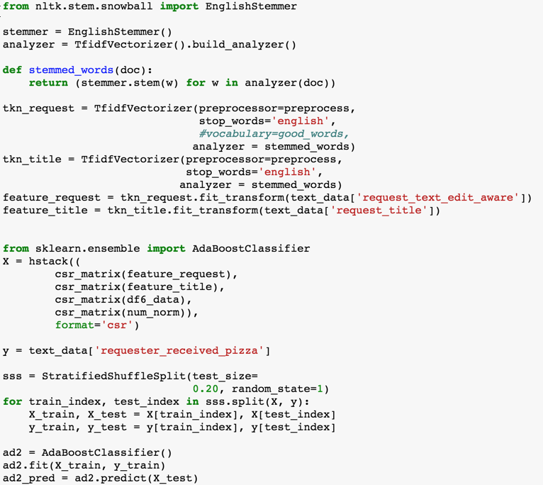
Sensible Methods - Final Model
Features
Binarized Data
Normalized Numeric Data
Text Data
Custom preprocessor
English stemmer
TfidfVectorizer()
Classifiers
AdaBoosterClassifier()
Base_estimator: DecisionTree()
Notes:
Jayashree
Our final model put together the binarized categorical, normalized numeric, and text features. We found that a AdaBoostClassifier with the default base_estimator DecisionsTree() was the best model for classifying random acts of pizza. It is interesting to note that our second best model used DecsionTree() on its own, and AdaBoost gave us a 0.2% increase. For those that didn’t try AdaBooster Classifier for your models, here is an overview: Adabooster starts off fitting a classifier on the original dataset and then fits additional copies of the classifier on the same dataset but weights incorrectly classified instances so they are not as relevant. We use GridSearch_CV to try and tune various parameters of AdaBoost, but they were not as effective as the default settings.
To groom the text data, we used the Tf-idf algorithms. TF-IDF reviews both how frequent a term is in a success, and how infrequent it is a in a fail. So, if the word “please” is common in both successful pizza requests and unsuccessful pizza requests, it would be given a low rate by Tf-idf. But if the word “surprise” is common in a successful request and is uncommon in an unsuccessful pizza request, it will be given a low weight by Tf-idf. We netted almost half a percent when we used word stemmers in a Tf-idf, so we included them. A word stemmer returns all tenses of a word as a single word. So, “go”, “going”, “gone”, and “went” all return the same stem “go.” The custom pre-processor was used by Nikki in exercise 2 and was very helpful for that assignment.

Slide 9
Error Analysis
Confusion Matrix
Confusion matrix and evaluation measures for final model:
There are more false negatives than false positives
Error rate = 26%
Accuracy = 74%
Sensitivity = 43%
Specificity = 22%
Errors appear to be from model overfitting
Predicted Values
 | No Pizza | Got Pizza
No Pizza | 562 | 47
Got Pizza | 163 | 36
Actual Values
Notes:
Jayashree
Kaggle submissions are expensive; you only get 5 per day per person. So before submitting a test result to Kaggle for scoring, we wanted to do our own analysis. We utilize a classification report for all models as our first line of defence against bad models. If a model seems promising (anything over 65%), we would conduct additional analysis. A confusion matrix would tell us what our type I and type II errors were. The most common error was type II error where the model incorrectly marked successes as failures. We suspect this is due to model overfitting because the most accurate model included all the subreddits in the subreddit membership space.
Before submitting a promising test result set to Kaggle, we also checked to see if the average of successful predictions was similar to the average of successful training. I don’t know if the competition creators split the dataset into training and testing randomly, but if they are good stewards of science they did. Thus, the correct average prediction over the set would be near or identical to the training set’s average prediction. The training set’s prediction rate was about 10%, so any model that was too far from that metric was not submitted to Kaggle.
The measures:
Error Rate = (FP+FN)/(P+N)
Accuracy = (TP+TN)/(P+N)
Sensitivity = TP/P
Specificity = TN/N

Slide 10
Final Scores and Overall Results
F1 Score of final model:
0.70
Current kaggle score:
0.53656
Future Improvements:
Research new algorithms beyond the scope of this class to deal with large sparse feature matrices
Notes:
Jayashree
Our final F1 score is for the model that gave us the highest Kaggle score among the submissions. Our F1 score was 70%, which is near to the F1 score that the Stanford team got who first made this problem famous. When we submitted our results to Kaggle, we found that our model was better than flipping a coin, so that’s a win at least. On the RAOP public leaderboard, we can see that our model predicts better than 100 other models in this competition

Slide 11
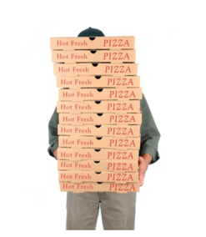
Thanks all!
Notes:
Jayashree

